Slide 1


MIS 6382.502
PYTHON
PROJECT
TEAM: WORK WIZARD(GROUP 1)
AKANKSHA KATOCH (AXK230026)
DEV JOSHI (DXJ220017)
ISMAEL ROMERO (IXR160130)
KHOA NGUYEN (KNN170130)

Slide 2

CONTENT
01
DATA INFORMATION
02
DATA SET
03
DATA CLEANING
04
VISUALISATIONS
05
RECOMMENDATION
06
CONCLUSION

Slide 3

DATA INFORMATION
The provided data depicts the borrowing patterns of nine unique books over the span of a year-long analysis. Using data provided by the library we analyze different parameters of customer habits based on the sub-classes provided. Null values were present in each category of our dataset.

Slide 4
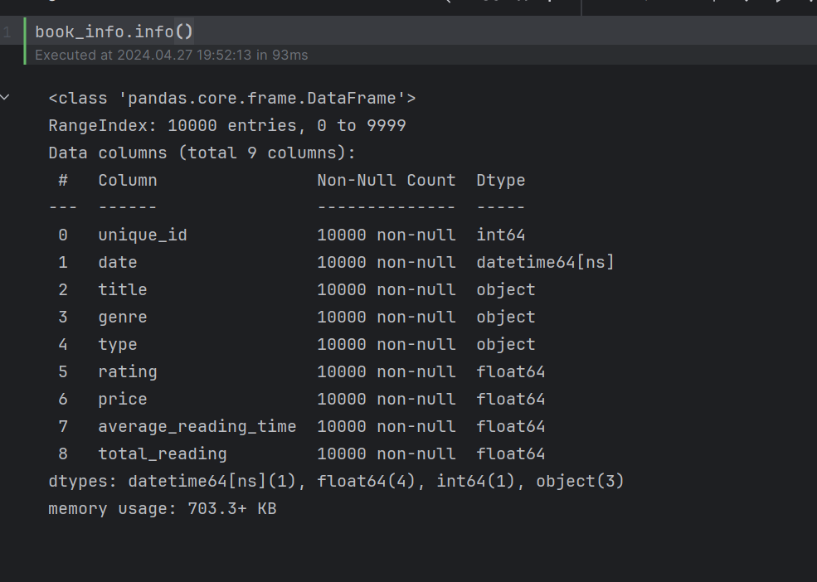
DATA SET
Unique ID: Each book has a unique identifier, useful for tracking individual entries.​
Date: The date on which each book was added to the catalog. This can be used to analyze trends over time. ​
Title: The title of the book.​
Genre: The genre of the book, such as Biography, Science, Mystery, etc.​
Type: The type of the book, categorizing it into broader sections like Fiction and Non-Fiction.​
Rating: The customer rating for each book, on a scale from 1 to 5.​
Price: The price of each book in USD.​
Average Reading Time: The average time, in hours, required to read the book, as estimated by surveys or historical data.

Slide 5
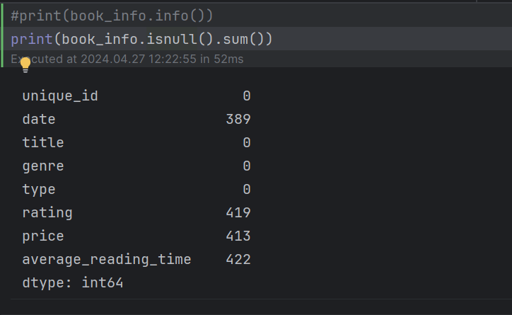
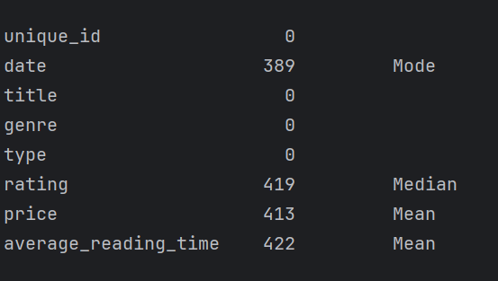
DATA CLEANING

Slide 6
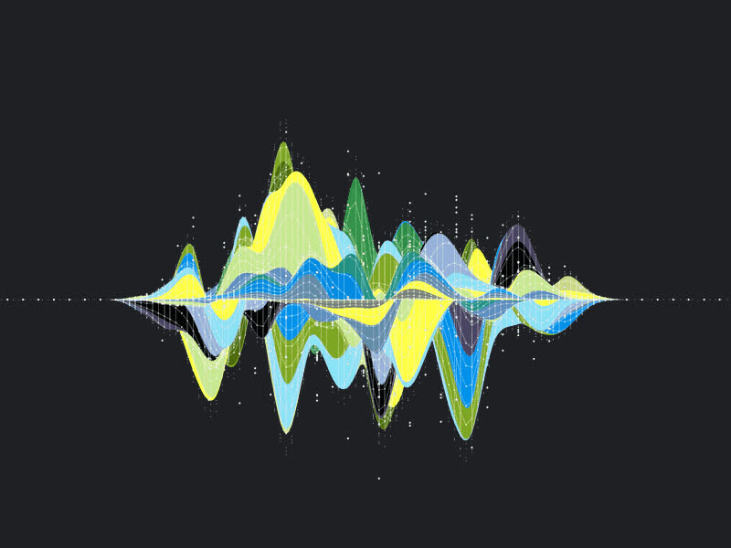

DATA VISUALISATION
Bar Charts
Boxplots
Line Plots
Scatter Plots
Histograms
Pie Charts
Heat Maps

Slide 7

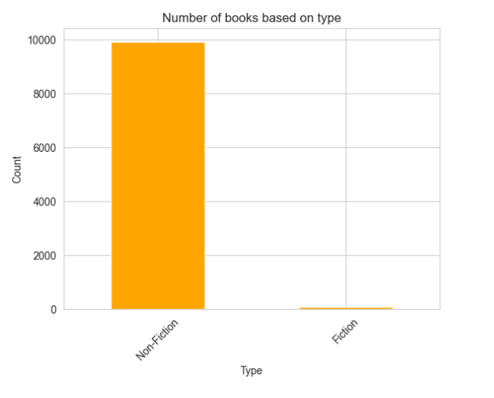
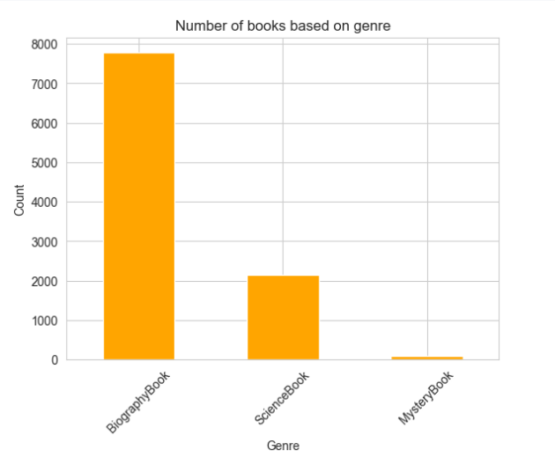
Bar Chart

Slide 8
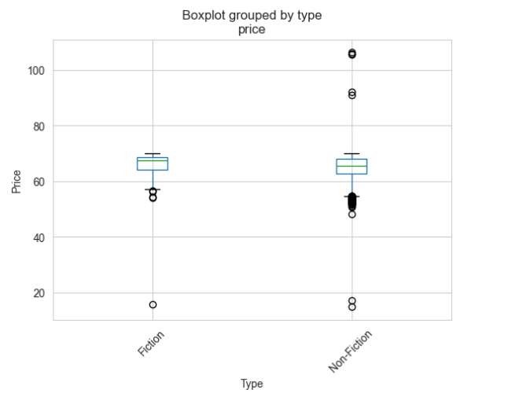
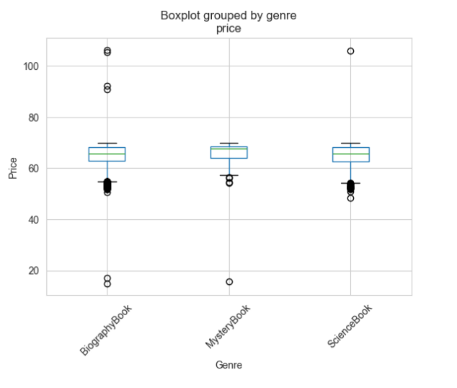
Box Plot

Slide 9
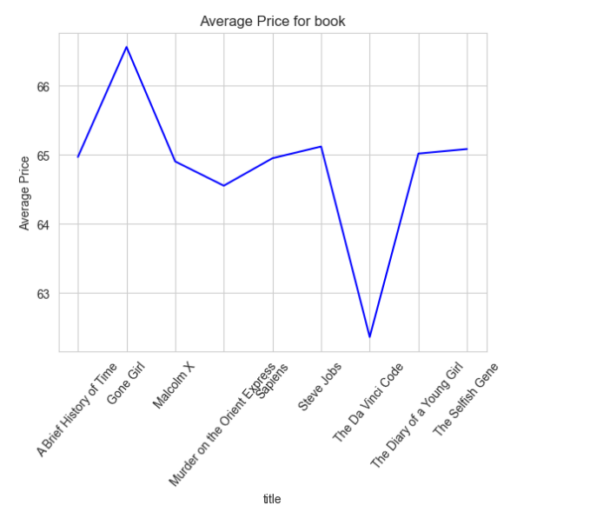
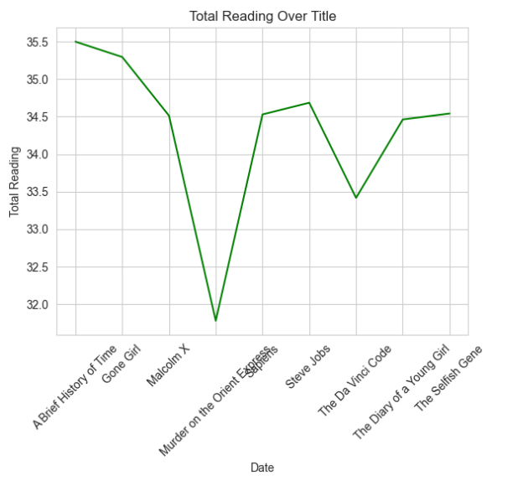
Line Plot

Slide 10
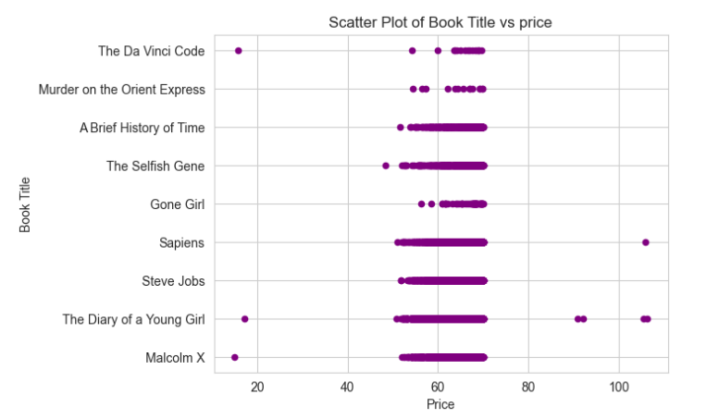
Scatter Plot

Slide 11
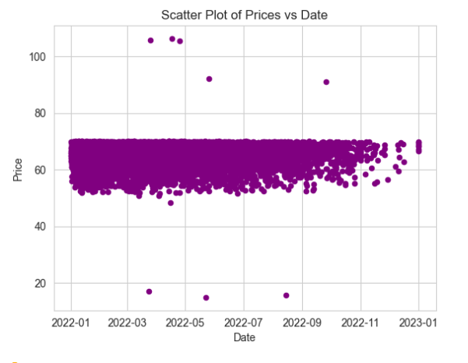
Scatter Plot

Slide 12
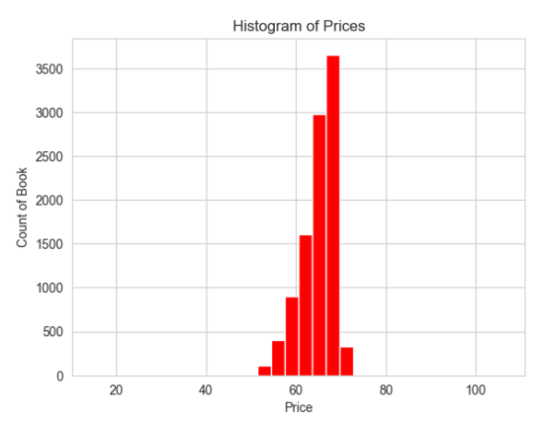
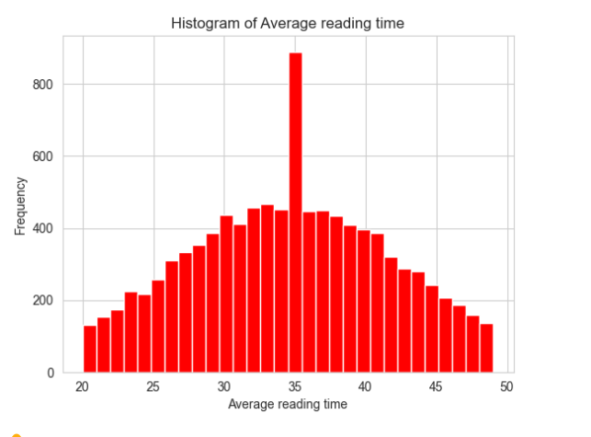
Histogram Plots

Slide 13
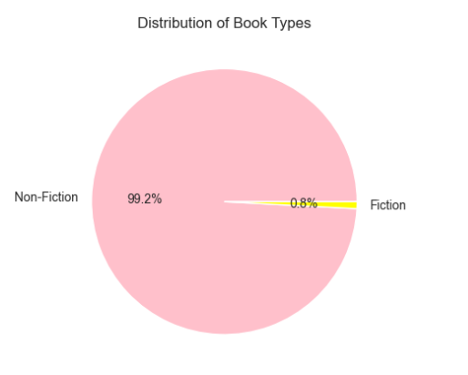
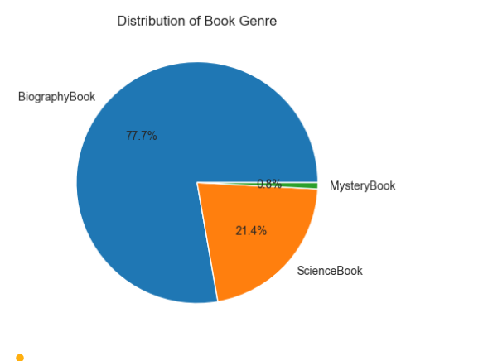
Pie Charts

Slide 14
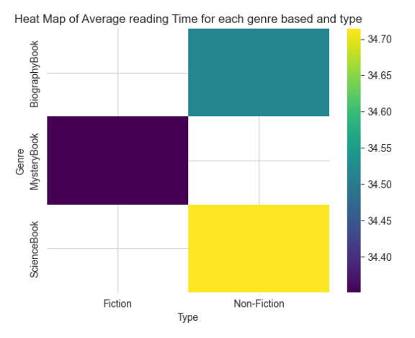
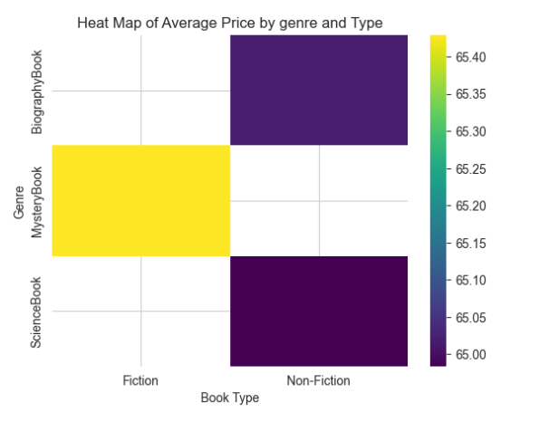
Heat Maps

Slide 15
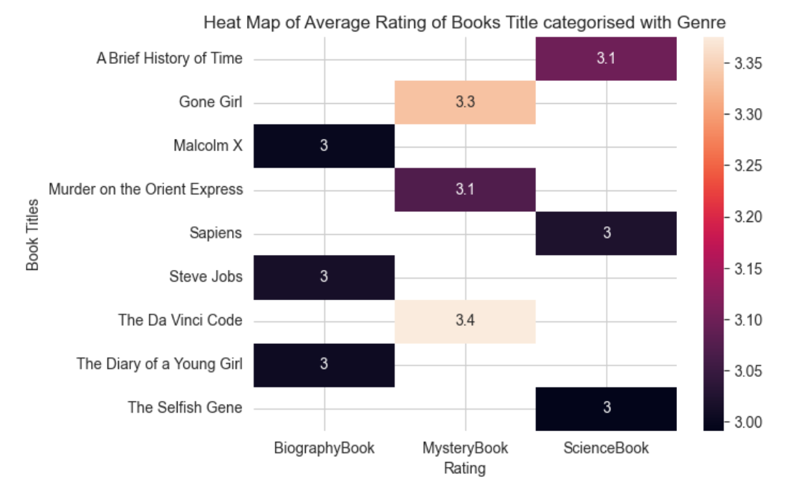
Heat Maps

Slide 16

RECOMMENDATION
Expand the pool of distinct book types to enhance diversity. ​
Introduce additional genres for Fiction books.​
Incorporate “Length of Book” as an additional subclass.
Introducing "Age of Customer" as a metric can yield deeper insights into our customer demographics and preferences. ​
The library can leverage the provided data to analyze trends aimed at enhancing customer retention and engagement.
​

Slide 17
Conclusion
Broad Range of Genres: The dataset is primarily composed of non-fiction, with biographies and science books being the most prominent, indicating a strong preference for informative content.
Pricing and Reading Time: The price and reading times of various book types vary significantly due to the diverse content available.
Price-Content Correlation: Non-fiction, especially biographies and scientific books, are typically priced higher and have longer reading times, indicating that readers value and are willing to pay for quality information.
Consumer Trends: Consumers are increasingly favoring detailed, substantial books, with a preference for higher-priced and longer-to-read options.
Market Implications: Publishers and booksellers can utilize these insights to effectively target their audience by focusing on popular genres and types that align with current reader preferences.

Slide 18
Non-fiction, especially biographies and scientific books, are typically priced higher and have longer reading times, indicating that readers value and are willing to pay for quality information.
The price and reading times of various book types vary significantly due to the diverse content available.
Price-Content Correlation:
Thank you!

